Slide 2
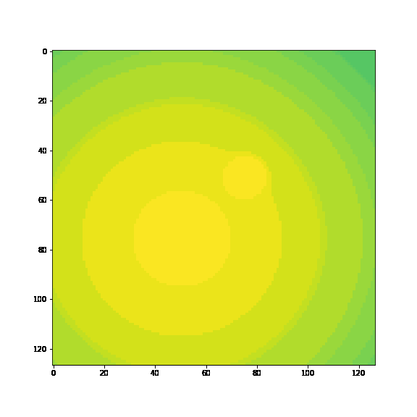
Multiscale in space and time. Toy1 is
2 times scales, 2 space scales

Slide 3
Having some trouble completely understanding MrCAE
How small should I compress down? It looks like Yuying’s code cuts in half every layer, toy1 has 3 layers. (smallest one he uses is 31x31 biggest 127x127)
I think I should start a lot smaller than this.

Slide 4
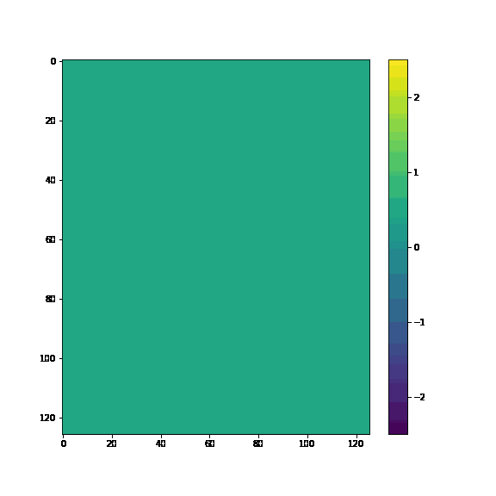
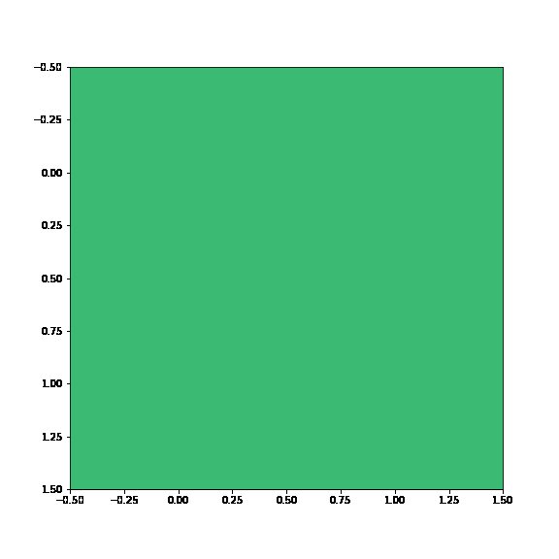
Using simple conv to predict to 2x2
Data on a 2x2 grid, these are the averages of each block

Slide 5
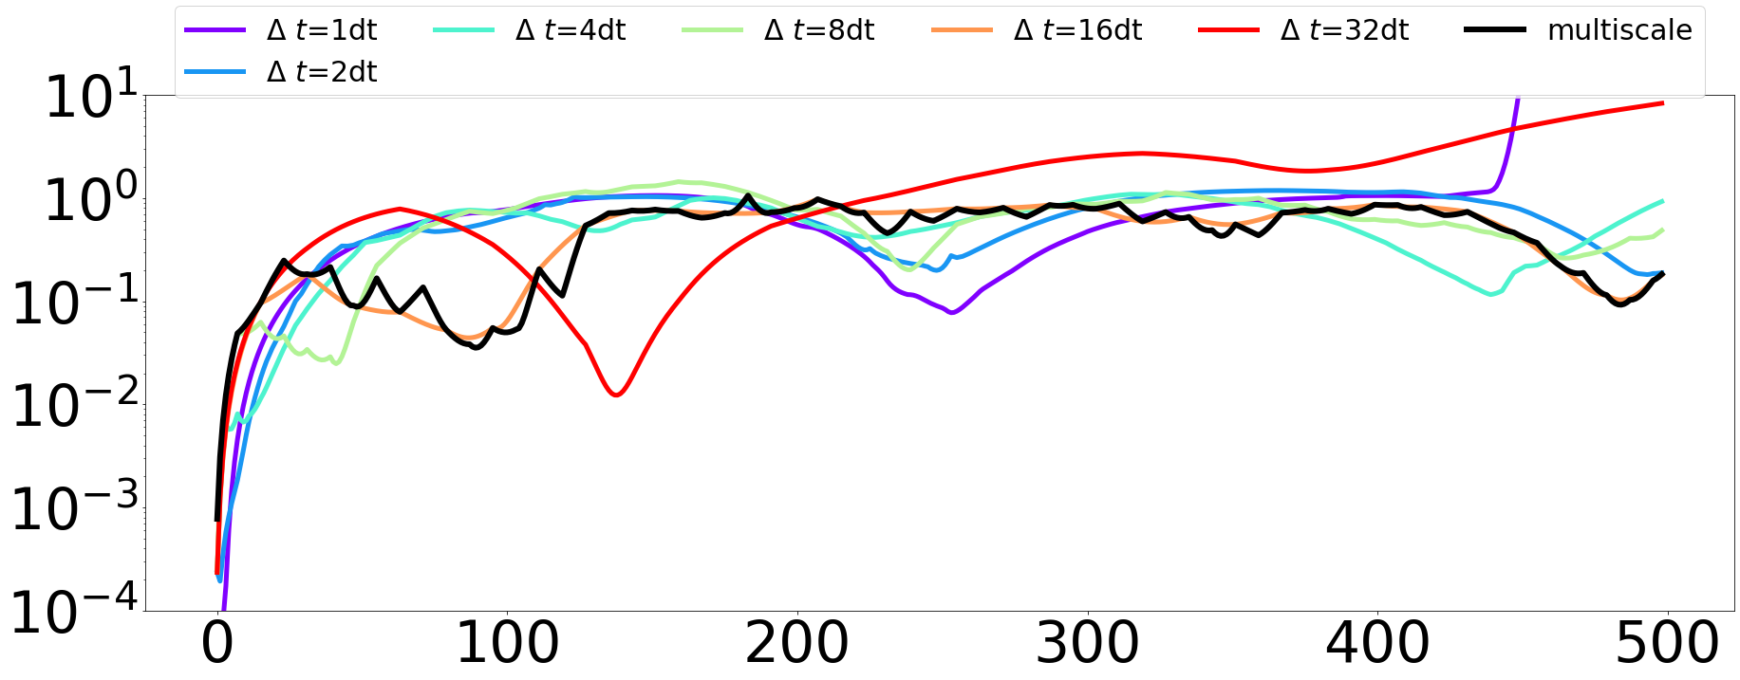
Predicting in time of a 2x2
These are the error on the 2x2 not the whole system
2x2 data is using the average of each block

Slide 6
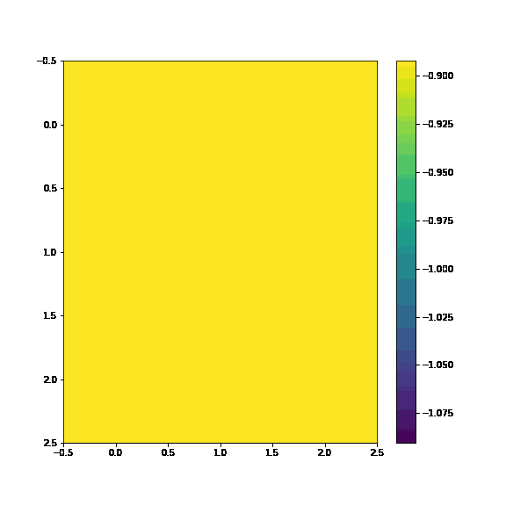
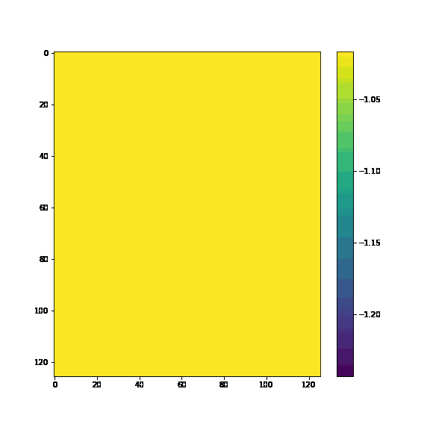
Also on 3x3
3x3 averages
3x3 simple autoencoder

Slide 7
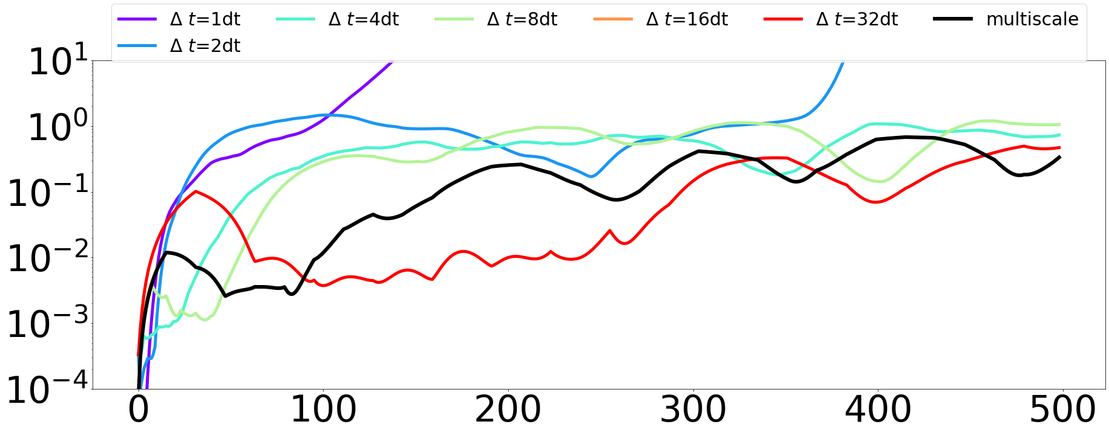
Predicting in time on a 3x3
The cross validation is only picking 1 timescale to use
3x3 data is using the average of each block

